Slide 1


Team Spatiotemporal: Indian Ocean yellowfin tuna
Jie Cao, North Carolina State University
Maxime Olmos, IFREMER
Spatial Stock Assessment Simulation Experiment
March 5, 2023
Wellington, New Zealand

Slide 2
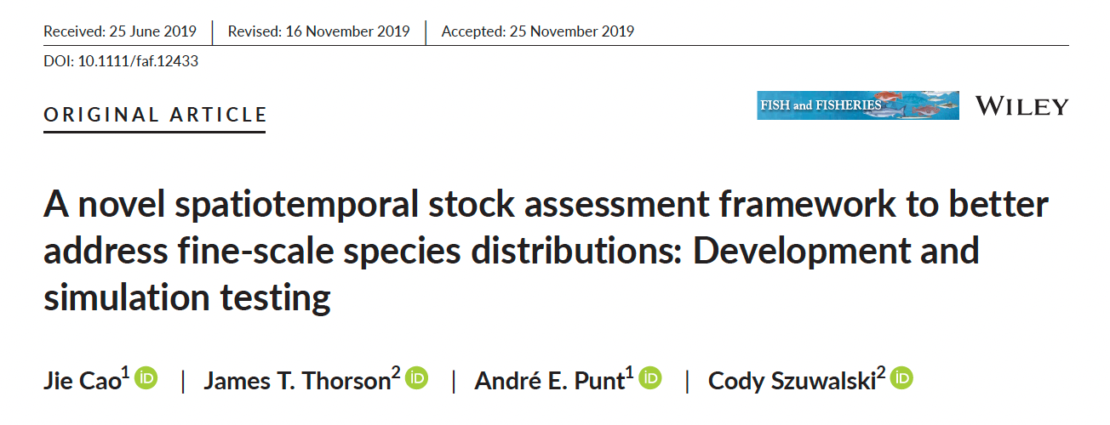
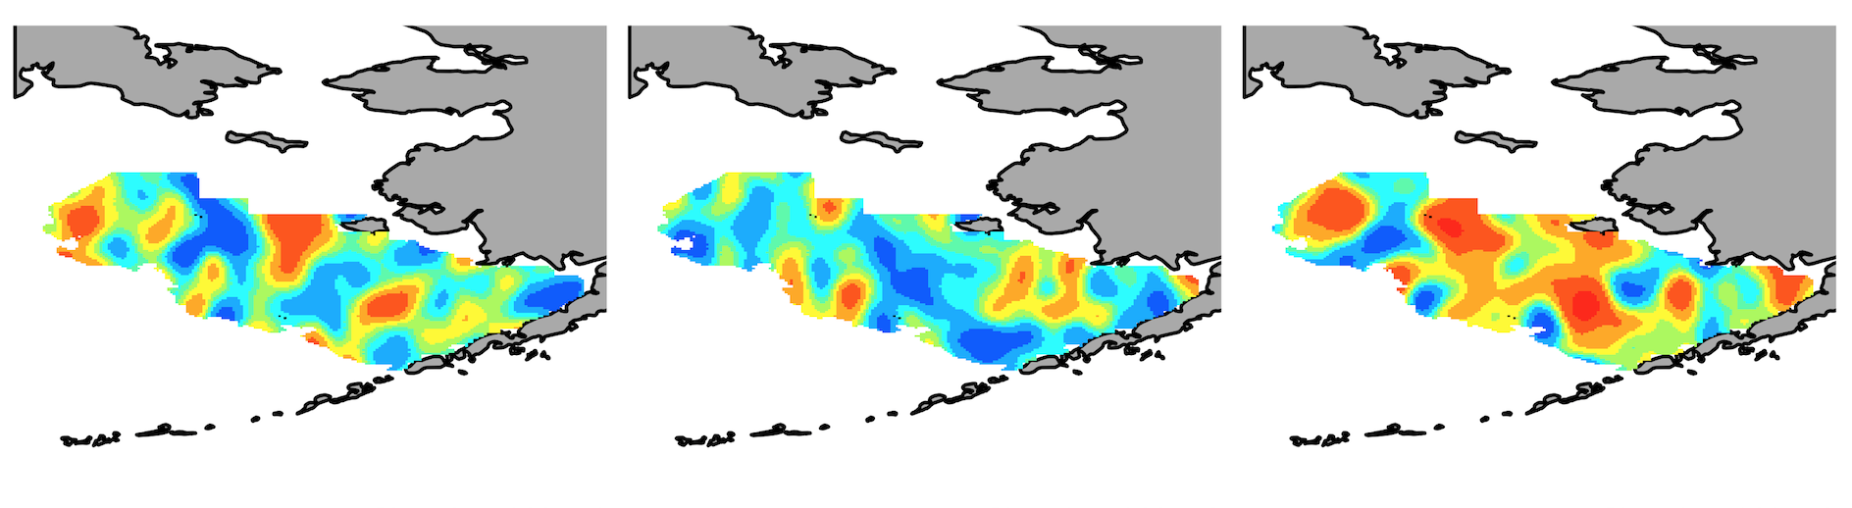
Spatiotemporal Model (STM) Overview
Predicted population density map
Estimated fishing mortality map
Predicted catch map
Estimated covariance of process error
Combines theory and methods from population dynamics and geostatistics
Assume population density varies continuously across space
Joint distribution for density at all locations
Expand to account for size-structured population dynamics

Slide 3
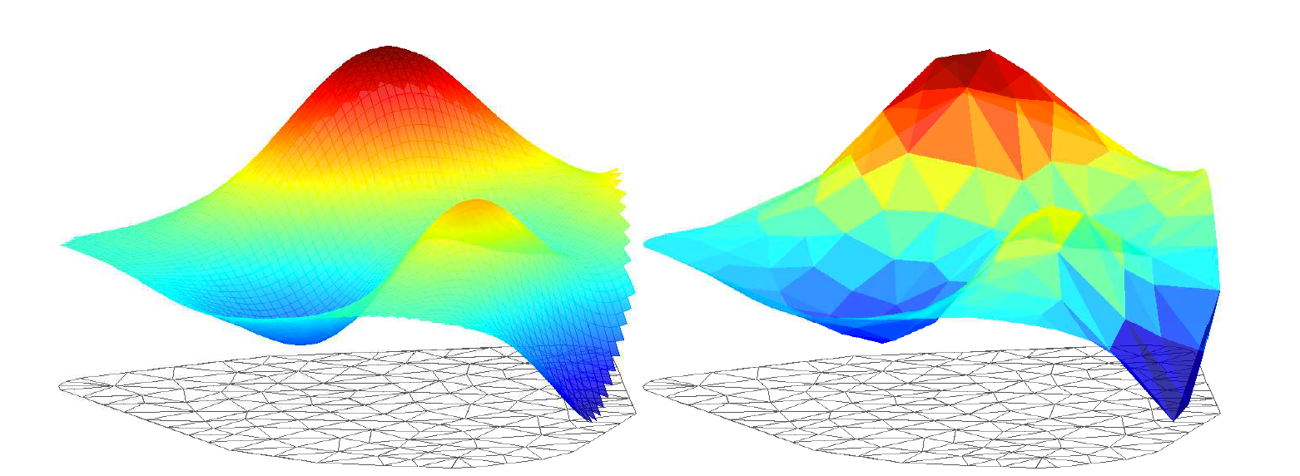
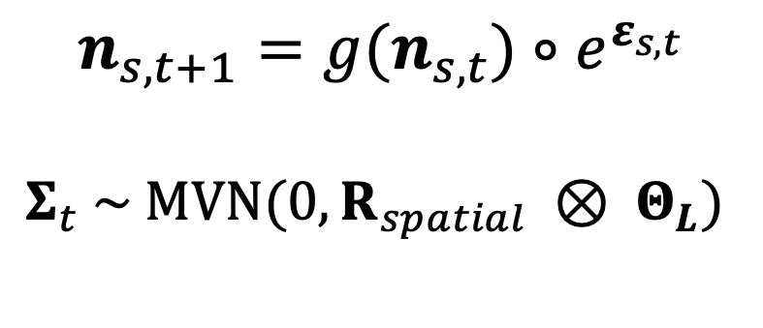
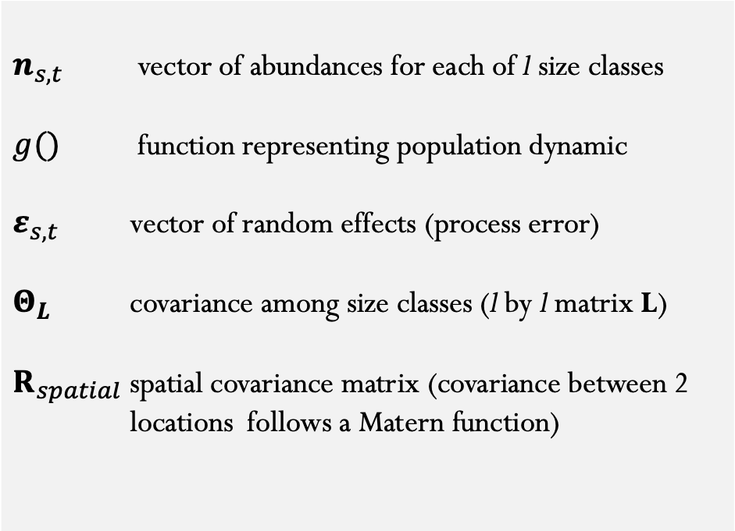
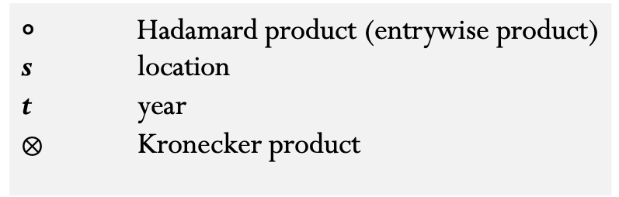
Process model
Abundance at size (n) for a given location s and time t
$$n_{s,t+1}=g(n_{s,t})∘e^{ε_{s,t}}$$
$Σ_{t} \sim MVN(0,R_{spatial} ⊗ Θ_{L})$
$n_{s,t}$ vector of abundances for each of l size classes
$g()$ function representing population dynamic
$ε_{s,t}$ vector of random effects (process error)
$Θ_{L}$ covariance among size classes (l by l matrix L)
$R_{spatial}$ spatial covariance matrix (covariance between 2 locations follows a Matern function)
$∘$ Hadamard product (entrywise product)
s location
t year
$⊗$ Kronecker product

Slide 4
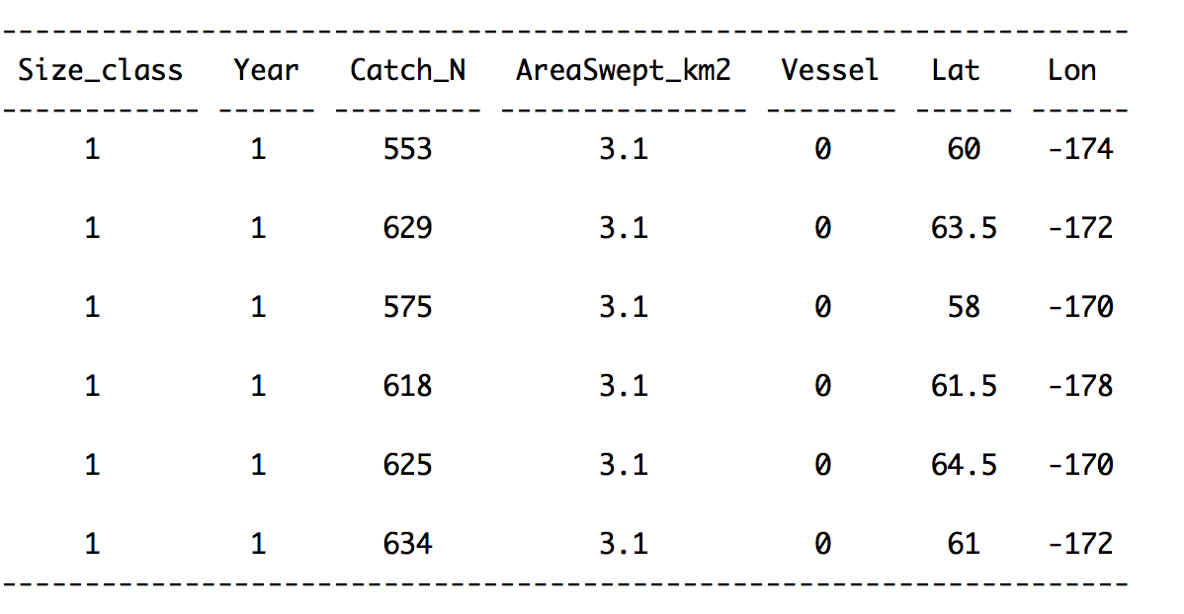
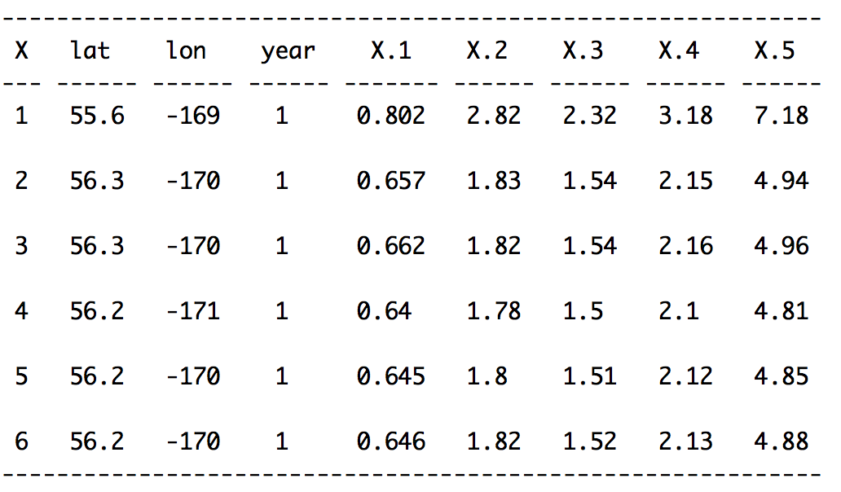
Input data
survey data
commercial catch data
fine scale
aggregated to knot-level
used to create mesh/knots

Slide 5
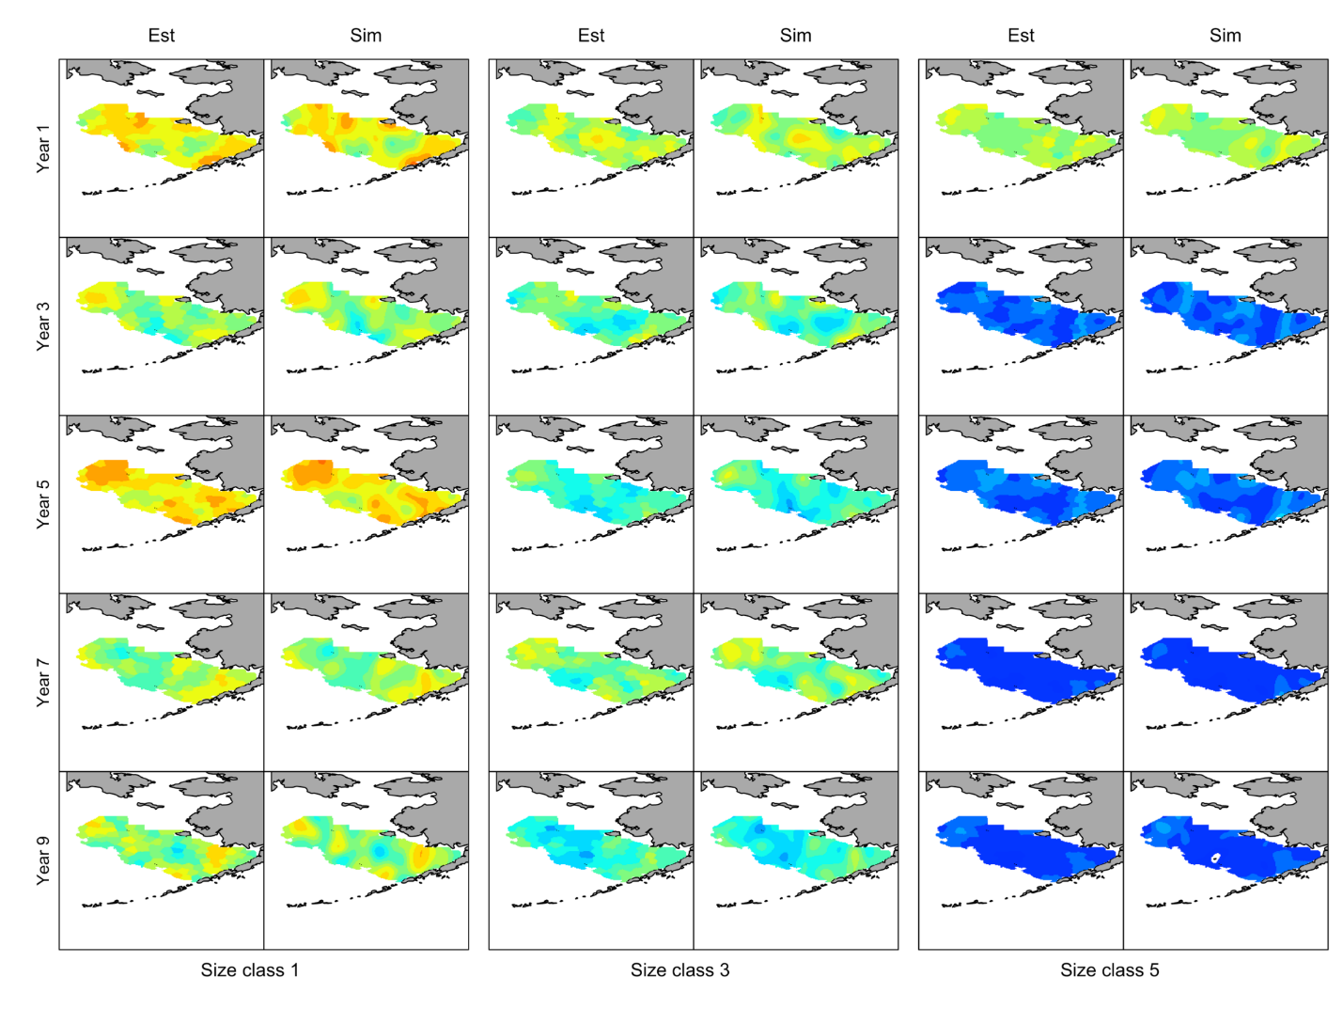
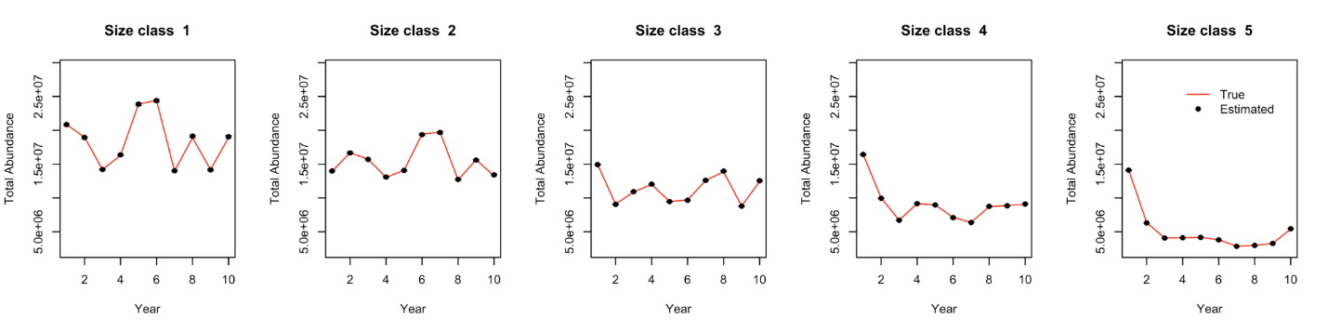
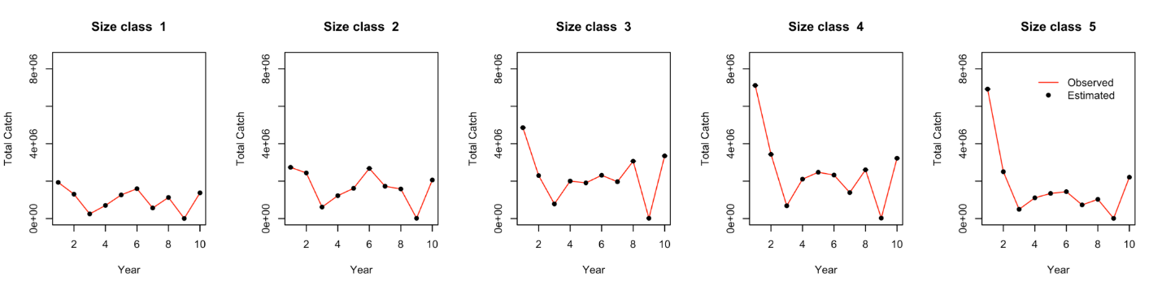

Slide 6

STM: Application to Yellowfin Tuna
Crustacean life history
Fisheries-independent survey (size-specific)

Slide 7
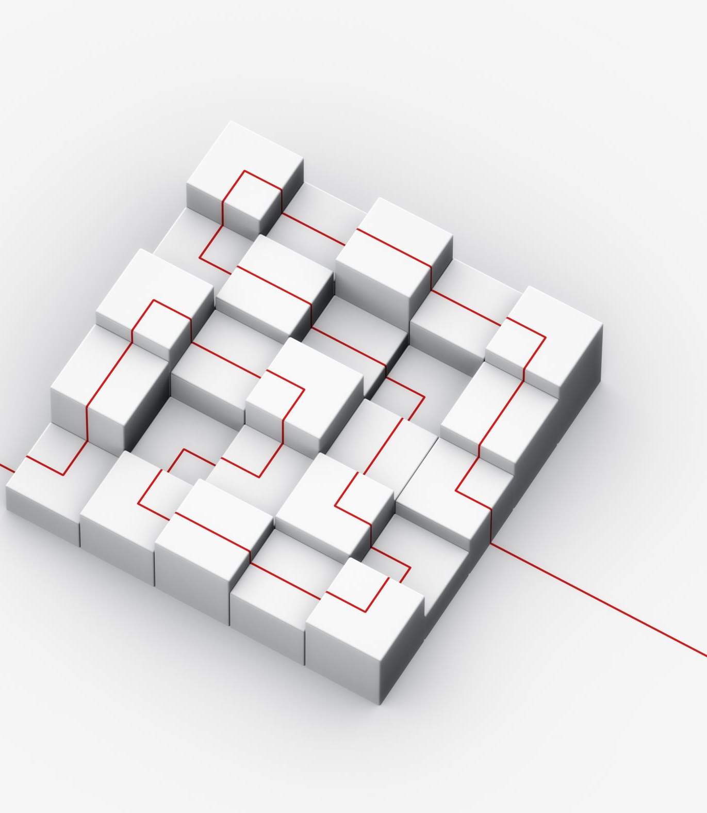
Model development - Pathway
Modified population dynamics
size-structured
Reduced dimension
#fisheries

Slide 8
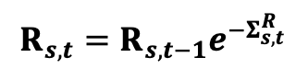
Spatiotemporal model – Yellowfin Tuna
State-space framework defined by two stochastic processes
X_{s,t}, t=1,…T and s=1,…S, and Y_{s,t} with discrete seasonal time steps t and knot locations s
Unobserved dynamic state process – describing underlying population dynamics
Observation process – linking observations to the true dynamics
$$R_{s,t}=R_{s,t−1}e^{−Σ_{s,t}^{R}}$$
$N_{s,t}^{1} ={(R}_{s,t}$ + ${N1}_{s,t−1}\left(1−invloigt\left(h_{s,t}\right)\right)$ ${(1−g}^{N1})e^{−M_{N1}})e^{−Σ_{s,t}^{N1}}$
.
.
.
$N_{s,t}^{L}={(N}_{s,t}^{L−1}\left(1−invloigt\left(h_{s,t}\right)\right)g^{L−1}e^{−M_{L−1}}$+$N_{s,t}^{L}\left(1−invloigt\left(h_{s,t}\right)\right)$ $e^{−M_{NL}})e^{−Σ_{s,t}^{NL}}$

Slide 9

Model development - Pathway
An operating model was developed
Age-structured
Same dimension as the YFT OM
Models developed | Description | Outcome
Version 1 | 5 size classes/fit to CPUE, combined total catch, CPUE composition, combined catch composition (cell-level data)
Version 2 | Same as version 1, but harvest rate was modeled using temporal random walk instead of GMRF
Version 3 | Same as version 1, but only has 2 size classes
Version 4 | Same as version 3, but harvest rate was modeled using temporal random walk
Version 5 | Not predicting catch (catch without error)

Slide 10
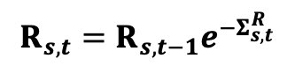
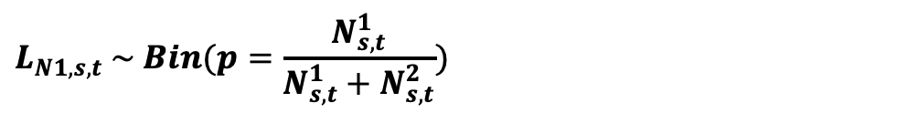
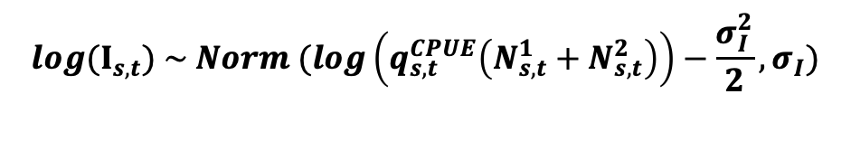
Model development – Version 5
Population dynamics
2 size classes (<50cm; >=50cm)
$$R_{s,t}=R_{s,t−1}e^{−Σ_{s,t}^{R}}$$
$N_{s,t}^{1} ={(N}_{s,t−1}^{1}−C_{s,t−1})(1−g^{N1})e^{−M_{R}}$+ $R_{s,t}$
$N_{s,t}^{2} ={(N}_{s,t−1}^{1}−C_{s,t−1}^{1})g^{N2}e^{−M_{N1}}$+${ (N}_{s,t−1}^{2}−$ $C_{s,t−1}^{2}) e^{−M_{N2}})e^{−Σ_{s,t}^{N2}}$
Observation model
$${log(I}_{s,t}) \sim Norm (log\left(q_{s,t}^{CPUE}\left(N_{s,t}^{1}+N_{s,t}^{2}\right)\right)−\frac{σ_{I}^{2}}{2},σ_{I})$$
CPUE:
$$L_{N1,s,t} \sim Bin(p=\frac{N_{s,t}^{1}}{N_{s,t}^{1}+N_{s,t}^{2}})$$
CPUE Comp:

Slide 11
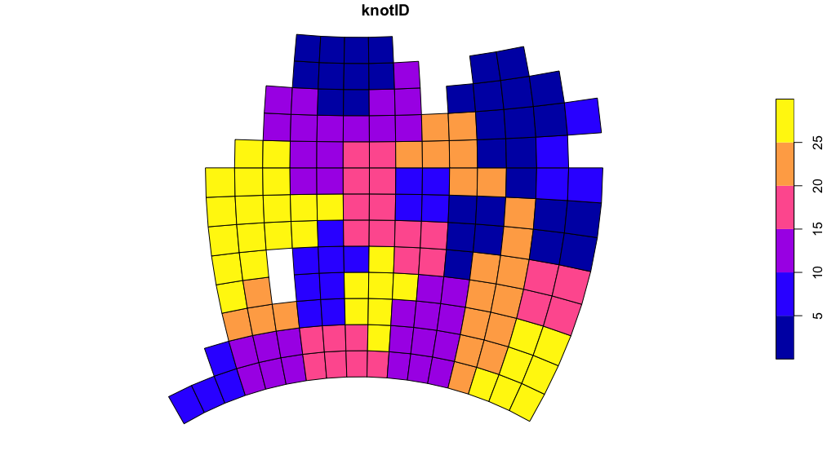
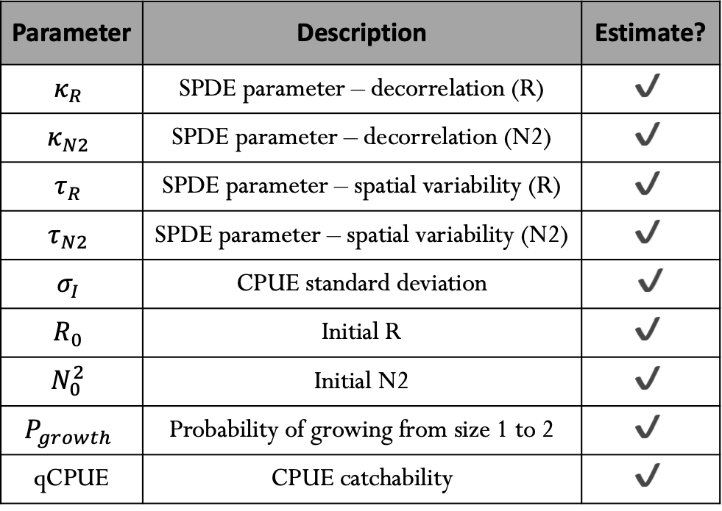
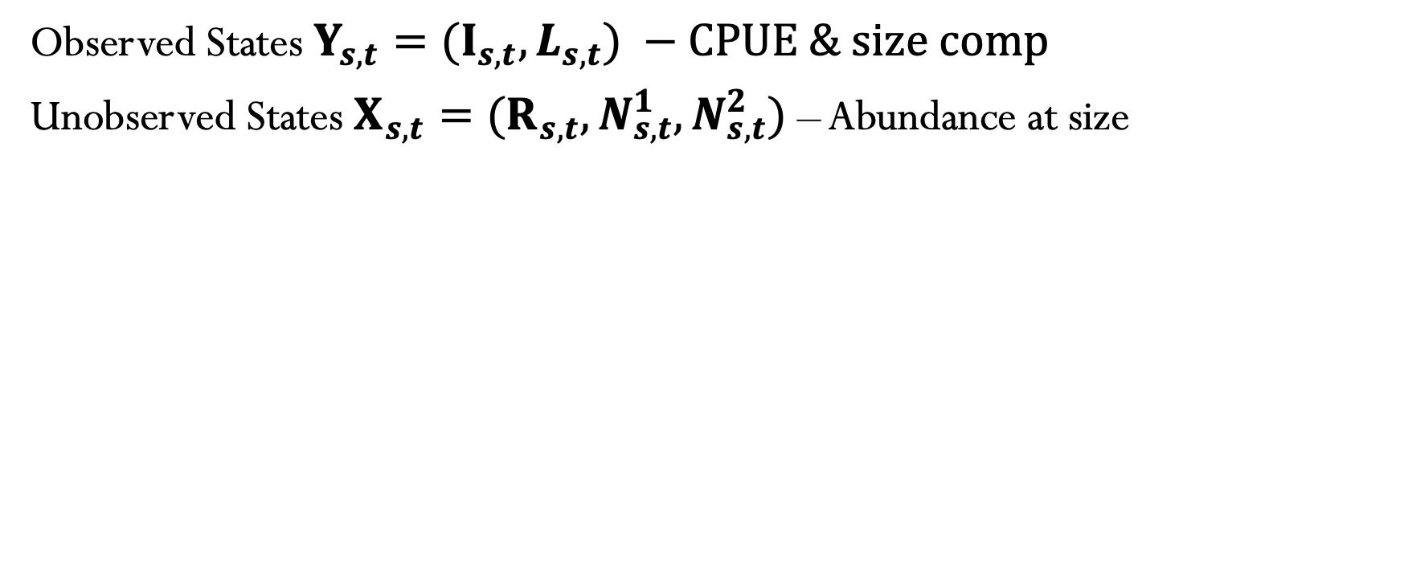
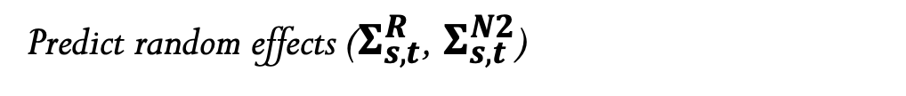
Model estimation
Observed States ${Y_{s,t}=(I}_{s,t},L_{s,t}) −CPUE \& size comp$
Unobserved States ${X_{s,t}=(R}_{s,t},N_{s,t}^{1},N_{s,t}^{2})$ – Abundance at size
Parameter | Description | Estimate?
$$κ_{R}$$ | SPDE parameter – decorrelation (R) | $$✔︎$$
$$κ_{N2}$$ | SPDE parameter – decorrelation (N2) | $$✔$$
$$τ_{R}$$ | SPDE parameter – spatial variability (R) | $$✔$$
$$τ_{N2}$$ | SPDE parameter – spatial variability (N2) | $$✔$$
$$σ_{I}$$ | CPUE standard deviation | $✔$
$$R_{0}$$ | Initial R | $$✔$$
$$N_{0}^{2}$$ | Initial N2 | $$✔$$
$$P_{growth}$$ | Probability of growing from size 1 to 2 | $$✔$$
qCPUE | CPUE catchability | $$✔$$
Predict random effects ($Σ_{s,t}^{R}$, $Σ_{s,t}^{N2}$)

Slide 12
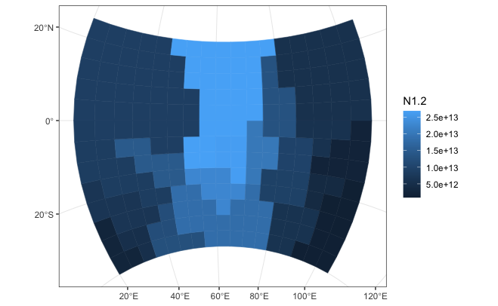
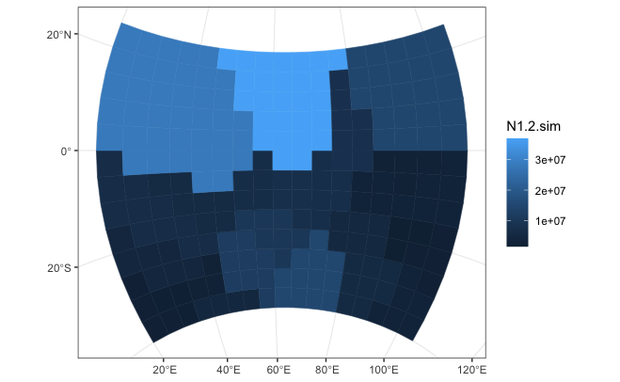
Results – simulated data

Slide 13
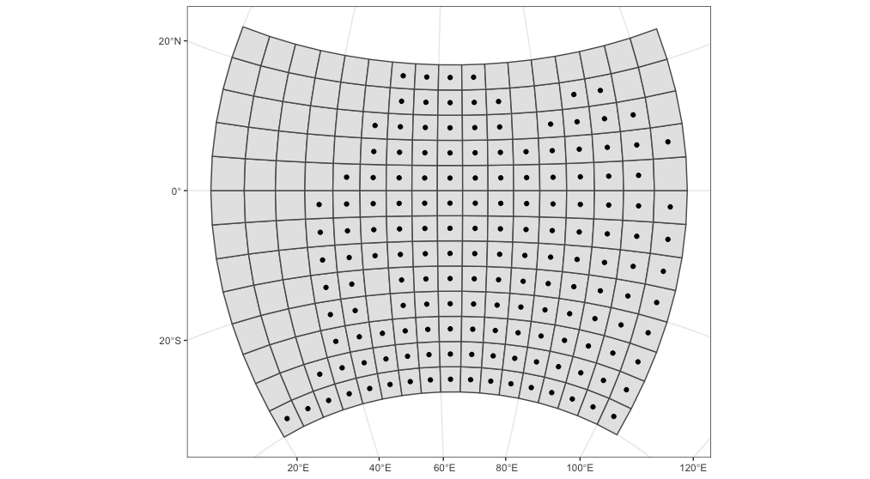
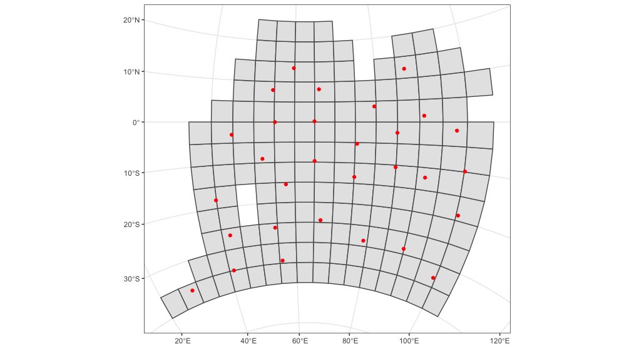
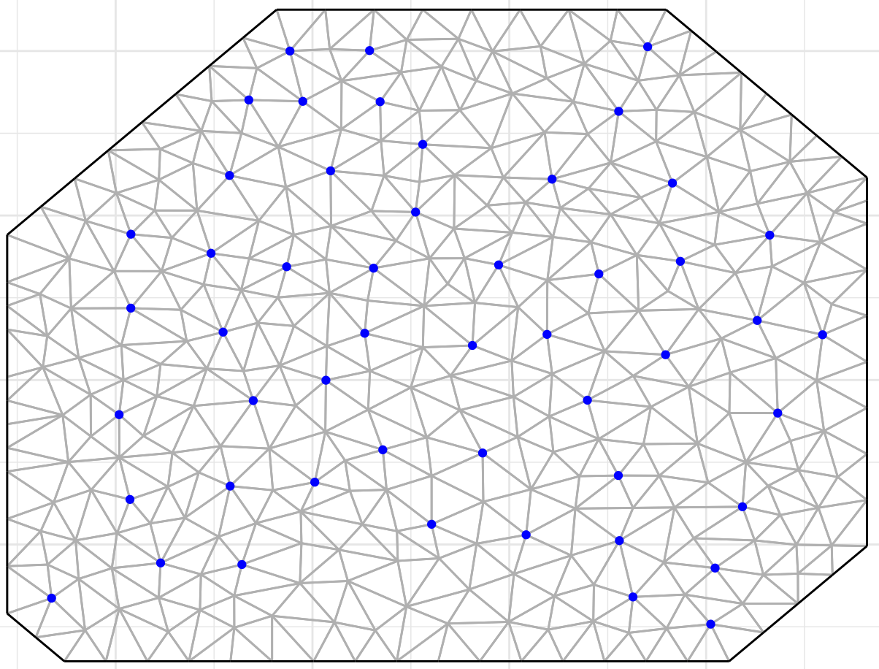
Model configurations
2 size classes (<50cm; >=50cm)
176 model pseudo-years (81-256)
2 GMRFs – residual spatial structure
25 knots
Combined fisheries (total catch; comps)
M fixed
Tagging data not used
Total catch (no error; 2 size bins)

Slide 14
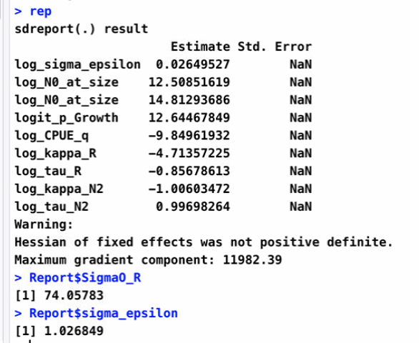
Results
Converged!
But…
Priors (q, growth rate)
Not converged! (high marginal field variance for R)

Slide 15
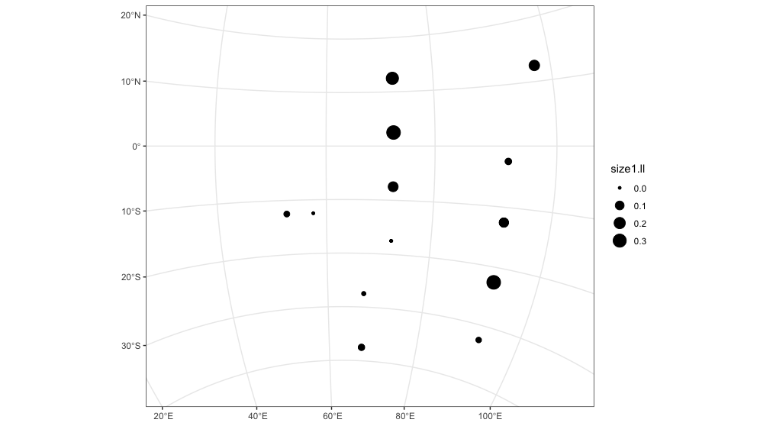
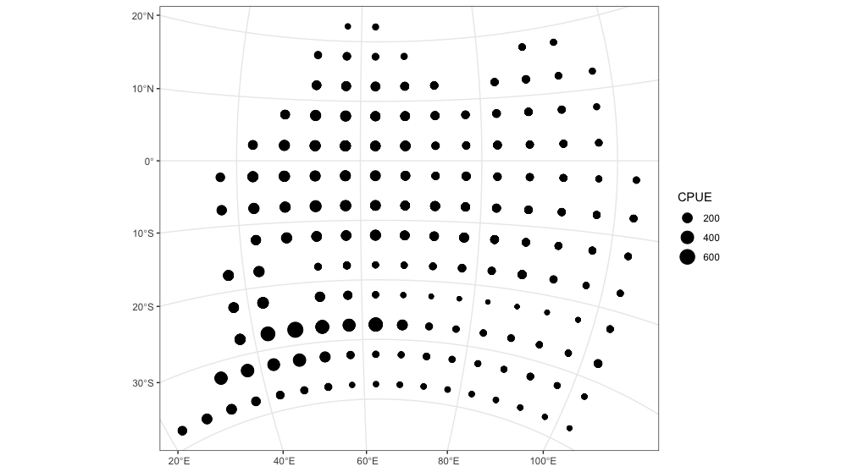
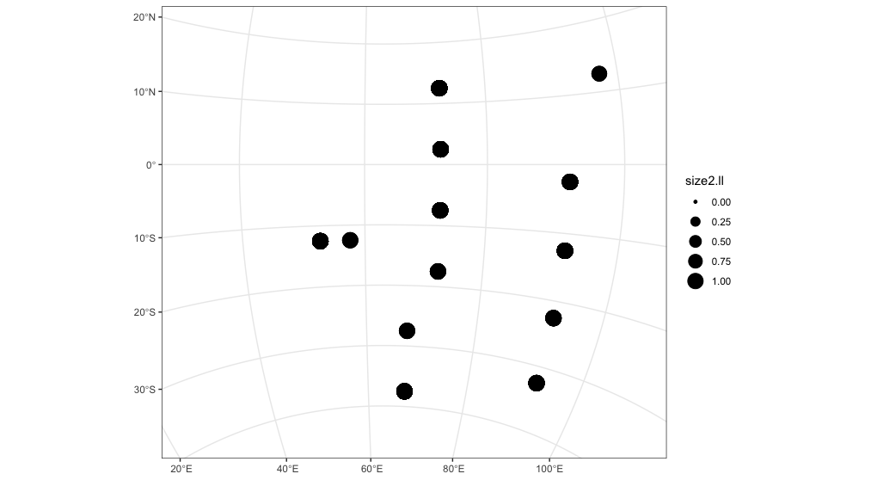
What we learned…
Model complexity vs data availability
Lack of data
Long run times
13 cells over 256 pseudo-years

Slide 16

Next steps
Continue the simulation study
Minimum data requirements for various scenarios
Model performance
Model diagnostics

